Slide 1
myServer 6
Sports Bar Systems
Allonis LLC

Slide 2
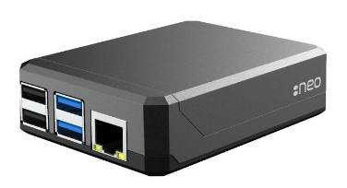
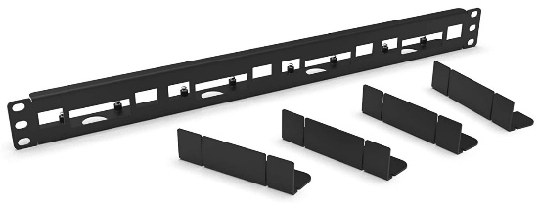
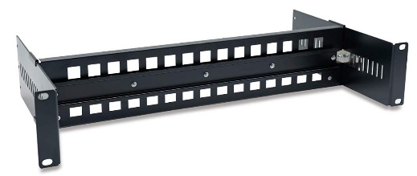
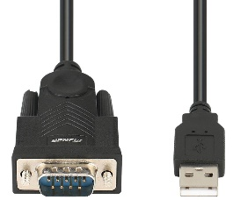
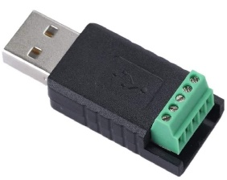
Allonis myServer 6 Pi Cases and Mounts
Basic heat sink case for most simple systems. Uses wall mount power supply. Included in “Basic” sports bar package
Rack Mount for up to four myServer 6 controllers or myMediaPlayers or myAudioStreamers
$125.99
Expandable DIN Rail Rack mount for complex systems including myIR8 HATs and myDigIO HATS
Priced according to needs (modular system). Typically $199 and up.
USB to Serial Adapter
$19.99
USB to RS485 Adapter
$23.99

Slide 3
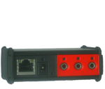

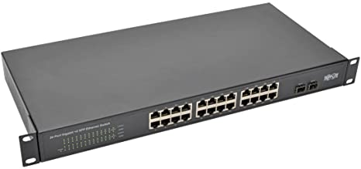
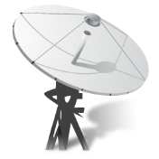
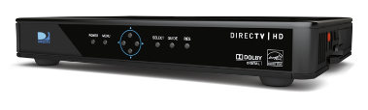
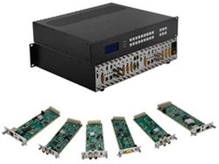

Video Connection Overview
IR emitter
Old IR TV
IP
Network
Switch
Network
IR
myServer 6
Controller
HDMI
IP
IP
LG / Sony
New TV
RG6
IP
IP
HDMI
DirecTV
Satellite
Video Distribution
IP
Cable
Provider
LG / Sony
New TV
RG6
IR Jack
Cat6
HDBaseT
Cat6 Ethernet
HDMI
Cat6 - HDBaseT
IR – 2 wire

Slide 4
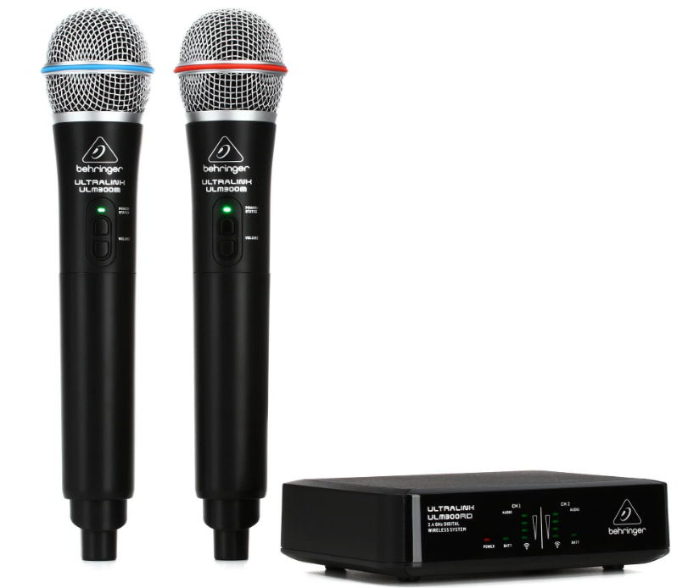
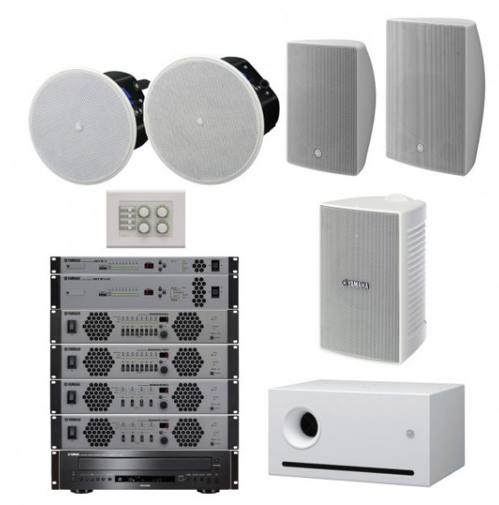

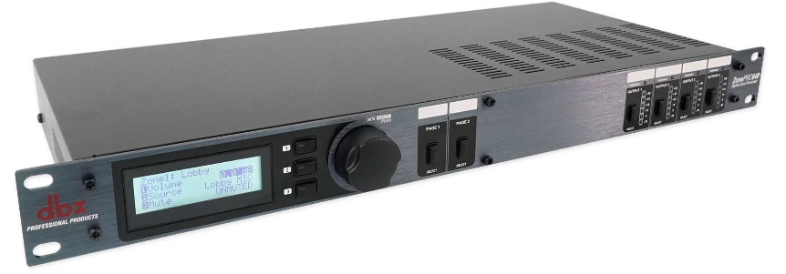
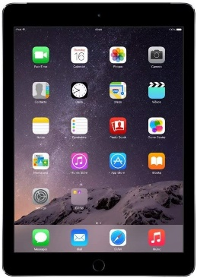
Audio Connection Overview
myServer 6
Controller
IP
Network
Switch
Wifi
AccessPoint
Microphone
DBX Audio
Processor
Multi Zone
Ampliers /
Speakers
(Crown / QSC / JBL / etc)
DBX 1261M is available pre configured for the system from Allonis
Any amplifier can work. Power control depends on amp.
iPad or Android Tablet / Phone

Slide 5
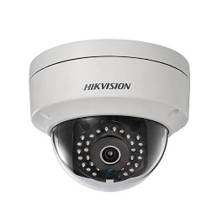
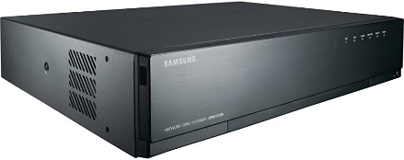
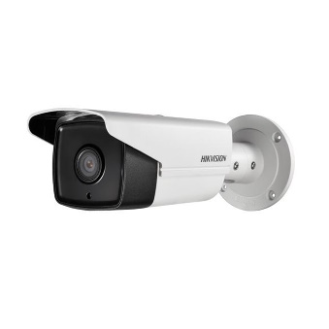
Camera Connection Overview
myServer 6
Controller
IP
Network
Switch
Wifi
AccessPoint
Camera
NVR
Cat6 Ethernet
Wifi
iPad or Android Tablet / Phone
Mjpeg IP Cameras

Slide 6
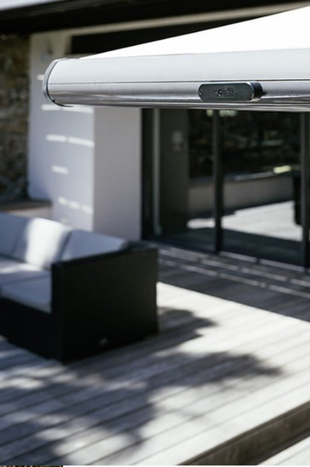
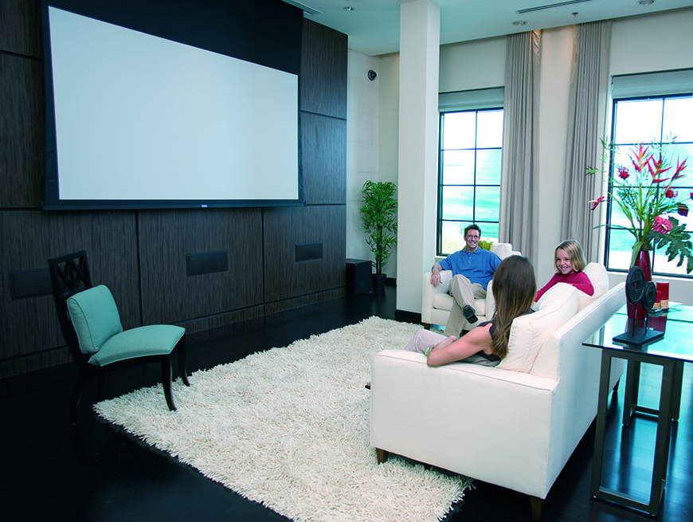
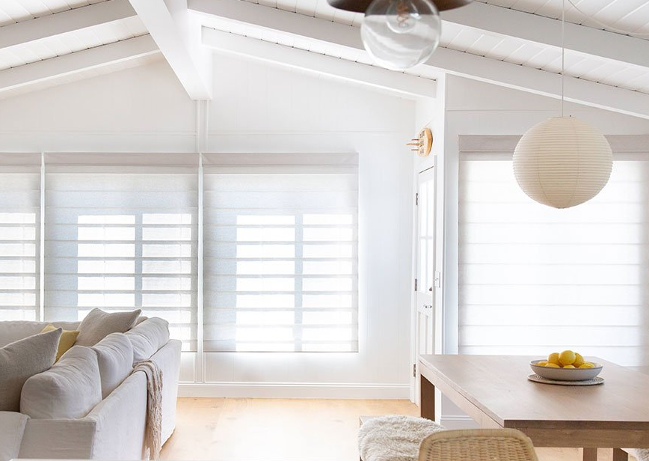
Shade Connection Overview
myServer 6
Controller
IP
Network
Switch
Outdoor Awnings
Wifi
AccessPoint
RS485
/ Z-Wave
Plus Power wires
Projection Screens
myZWave Shade Controller
(RS485 or Z-Wave)
Allonis is a dealer of Somfy shade motors
and can engineer a complete system.
iPad or Android Tablet / Phone
Blinds and Shades

Slide 7
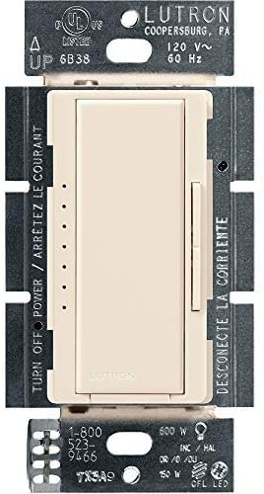

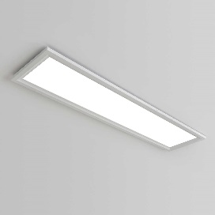
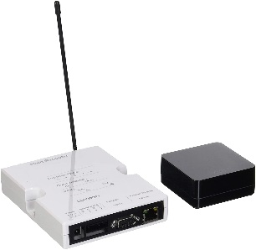
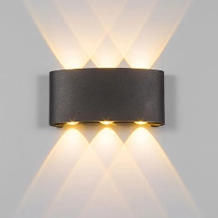
Lighting Connection Overview
myServer 6
Controller
IP
Network
Switch
Wifi
AccessPoint
Lutron
ClearConnect
RF
Lighting
Controller
Cat6 Ethernet
Lutron RadioRa2 example
Many other types are supported
Wifi
iPad or Android Tablet / Phone

Slide 8
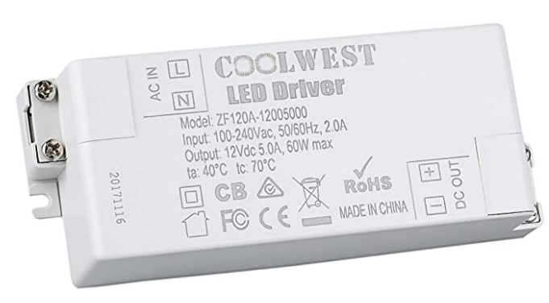
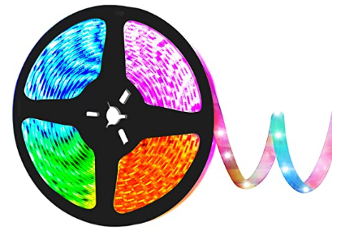
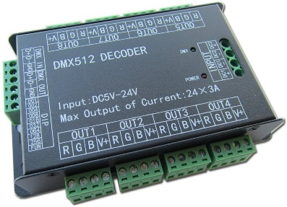
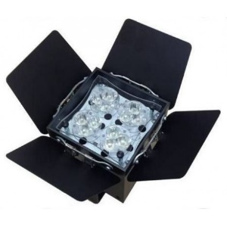
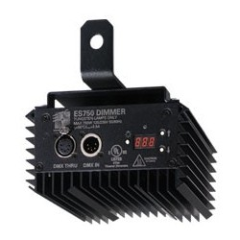
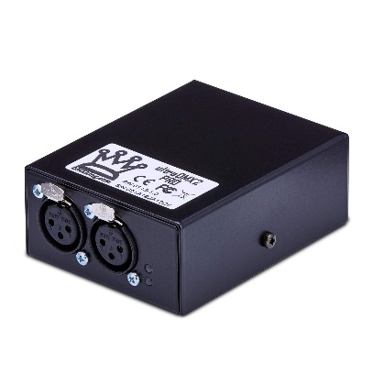
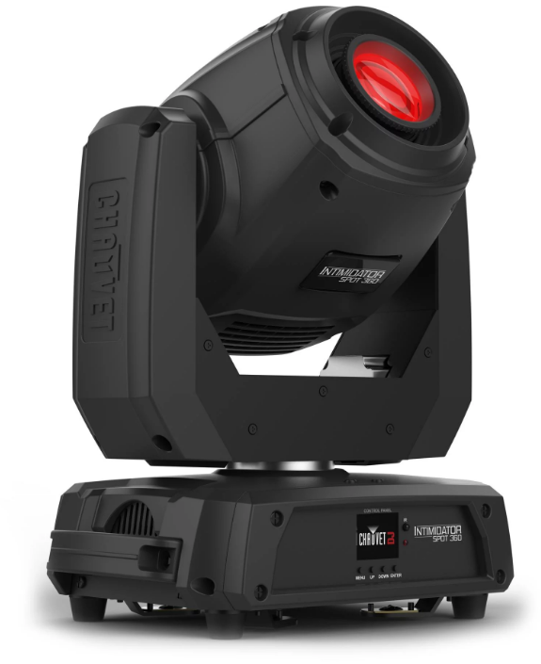
DMX Connection Overview
Power supply
RGB/W Lights
myServer 6
Controller
IP
Network
Switch
DMX / RGB Controller
Wifi
AccessPoint
DMX Cables
DMX Lighting
Controller
Cat6 Ethernet
Wifi
iPad or Android Tablet / Phone
DMX Devices

Slide 9
Media Support

Slide 10









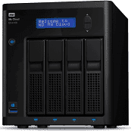











Movies
Media
Players
TV(s)
LG*
Sony*
Samsung*,**
others
AndroidTV*
AndroidTV*
On PC
Linux*
Server*
Player*
On PC
Copy Software
On PC
AndroidTV*
*
Video Distribution*
On PC
Apps running on
Media Players
NAS Storage*
Key
*Controlled by myServer via IP
**Controlled by myServer via IR
Dish/DirecTV
Satellite
Tizen*
CaptureCard
On PC
OTA on PC
myMediaPlayer*
Raspbian
On PC
On PC*
(check legality)
Handbrake
Transcoder PC
MacOS**

